Slide 1
PENTACOST
The Day God sent the Holy Spirit to stay with us

Slide 2

The Holy Spirit helped the disciples become God’s new family, the Church.

Slide 3

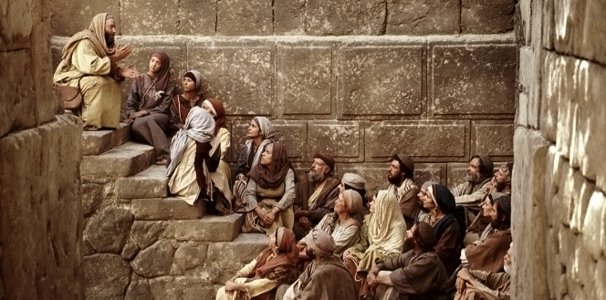
1. Who were the Apostles?
2. Who are Jesus’ disciples?

Slide 4
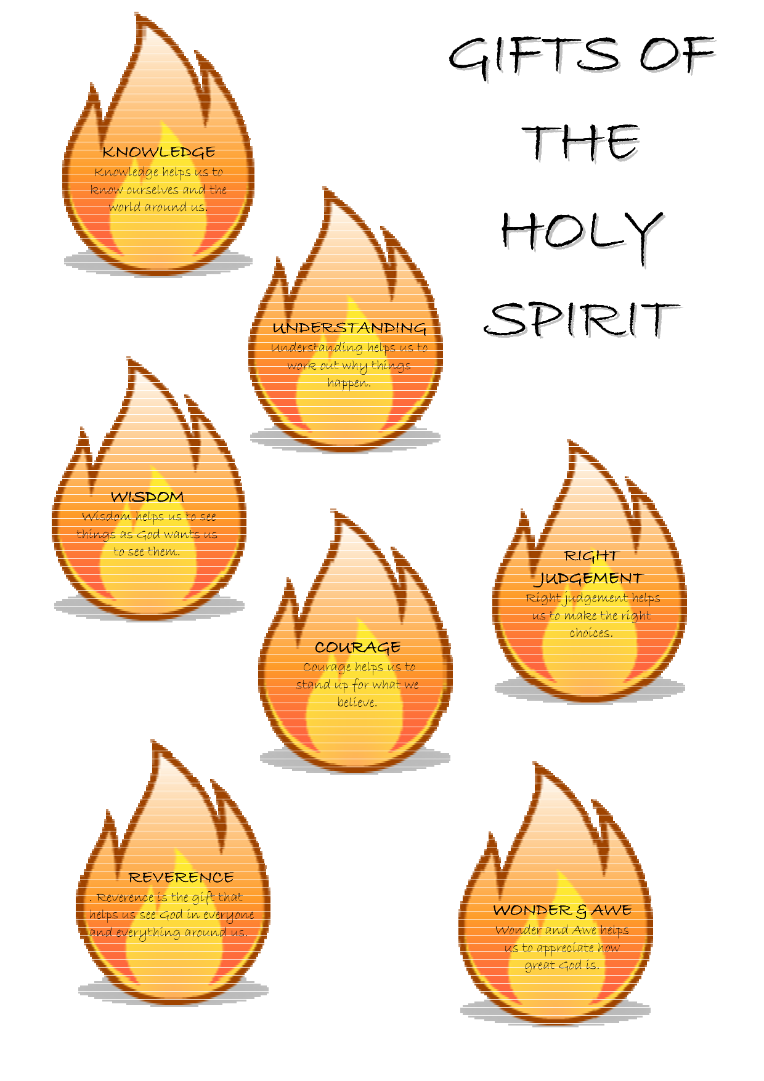
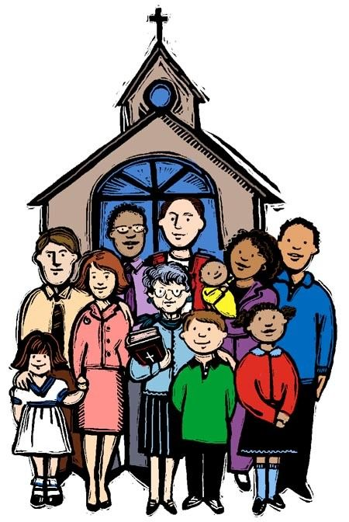
How does the
Holy Spirit help us today?
Personal way the Holy Spirit helps us:
Big Way the Holy Spirit helps us:

Slide 5
Jesus is with Us in His Church
Chapter 22 pg. 195
When did you become a member of the Church?
If you guessed when you were baptized, you are correct!
The people in God’s Christian family live in many different places in the world and speak many different languages.
But, they are alike in important ways. They all believe in Jesus and they have all been baptized in His name.

Slide 6
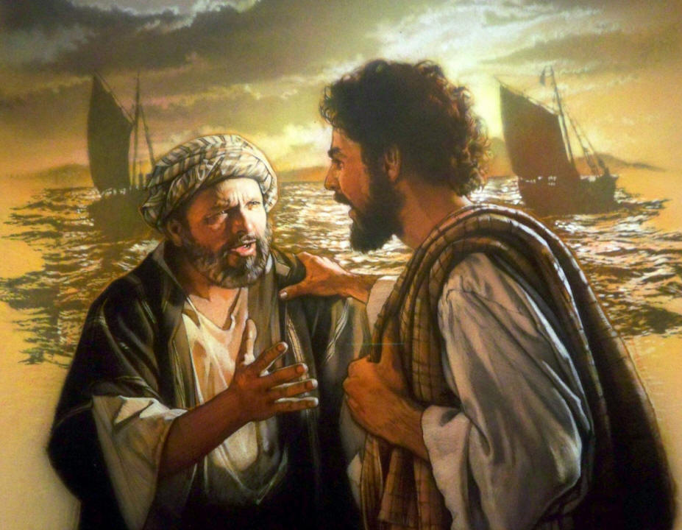
Jesus Chose a Leader for His Church. Pg. 196

Slide 7
All of us in the Church are called to be holy by being like Jesus. Pg. 195
Talk about the following with your family:
How can priests, like Fr. Scalia, Fr. Vu and Fr. Oetjen be like Jesus?
How can sisters, like Sr. Mary Sue, Sr. Melissa, Sr. Pat, and Sr. Helen be like Jesus?
How do your parents show Jesus’ love and care?
How do you show Jesus love and care?

Slide 8

The Pope Leads the Church Today pg. 197
There is an order to our Church.
P Pope Francis is the leader of our Catholic Church pg. 197
Cardinals - They elect the Pope and some are in charge of one or two diocese
Bishop Burbidge – Our bishop of the Diocese of Arlington - He is in charge of the parishes like St. James.
Fr. Scalia – The pastor of St. James Church
He is in charge of our church and the priests at our church.
Fr. Vu and Fr. Oetjen are
priests who guide us in our
faith.
Fr. Oetjen Fr. Vu
The priests in at St. James Church who lead and guide us to be disciples of Jesus.

Slide 9
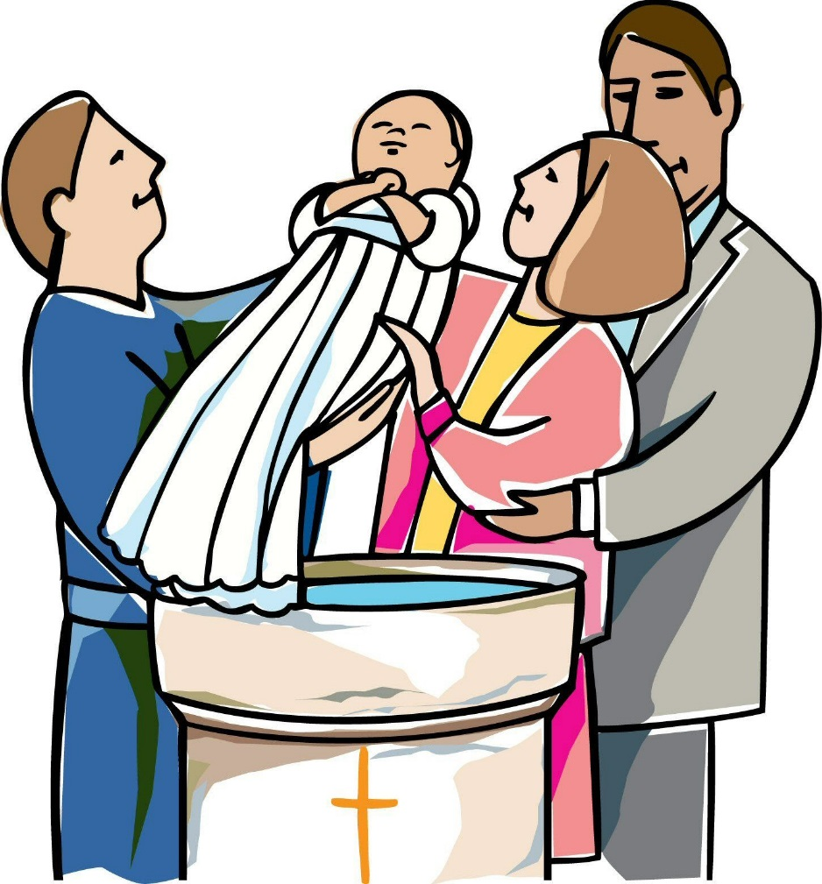
We Belong to the Catholic Church pg. 198

Slide 10
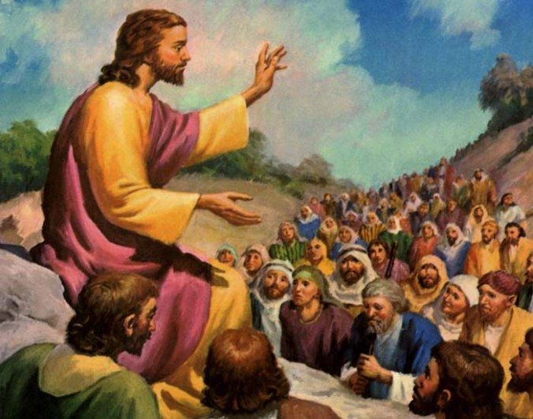

Slide 11
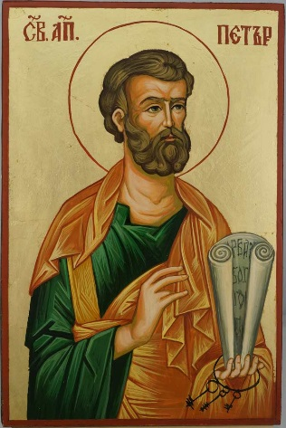
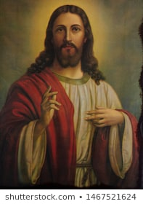
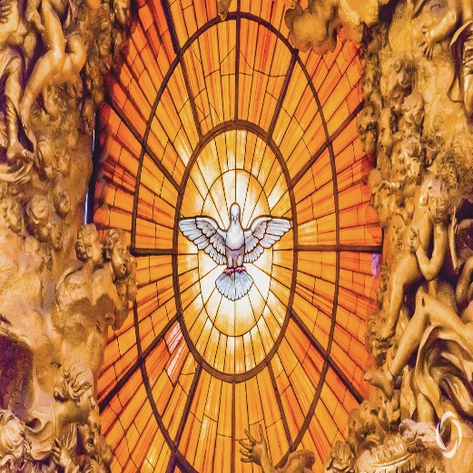
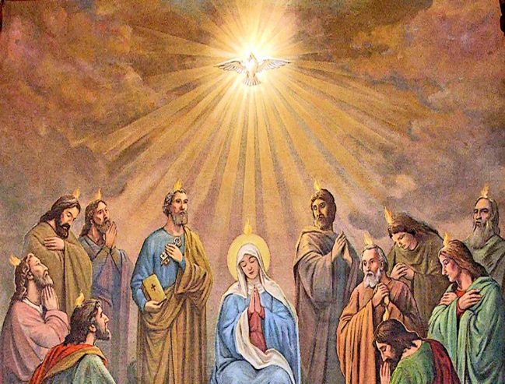
St. Peter
Jesus
Holy Spirit
Pope Francis
Mary, Peter, and the Apostles
1.Who was the first person that Jesus made the head of the Church?
5.Who said, “ I am always with you.”
I am now a Catholic.
2.Who said, “Simon, do you love me?
6.Who said, “Yes, Lord, you know that I love you”?
3.Who is the one sent by Jesus and the Father to help the apostles and us?
7.What name did you receive at Baptism that showed you belonged to God’s family?
4.Who said, “Teach everything I have said”?
8.Who first received the gift of the Holy Spirit?

